Slide 1
BMD ENG 301Quantitative Systems Physiology (Nervous System)
Lecture 15: Neural Circuits
2022_v1
Professor Malcolm MacIver

Slide 2
Neural Circuits
A step on the road to a neural system
Neural computation
Emergent property – can do more than what a single neuron can do

Slide 3
Spinal Cord

Slide 4
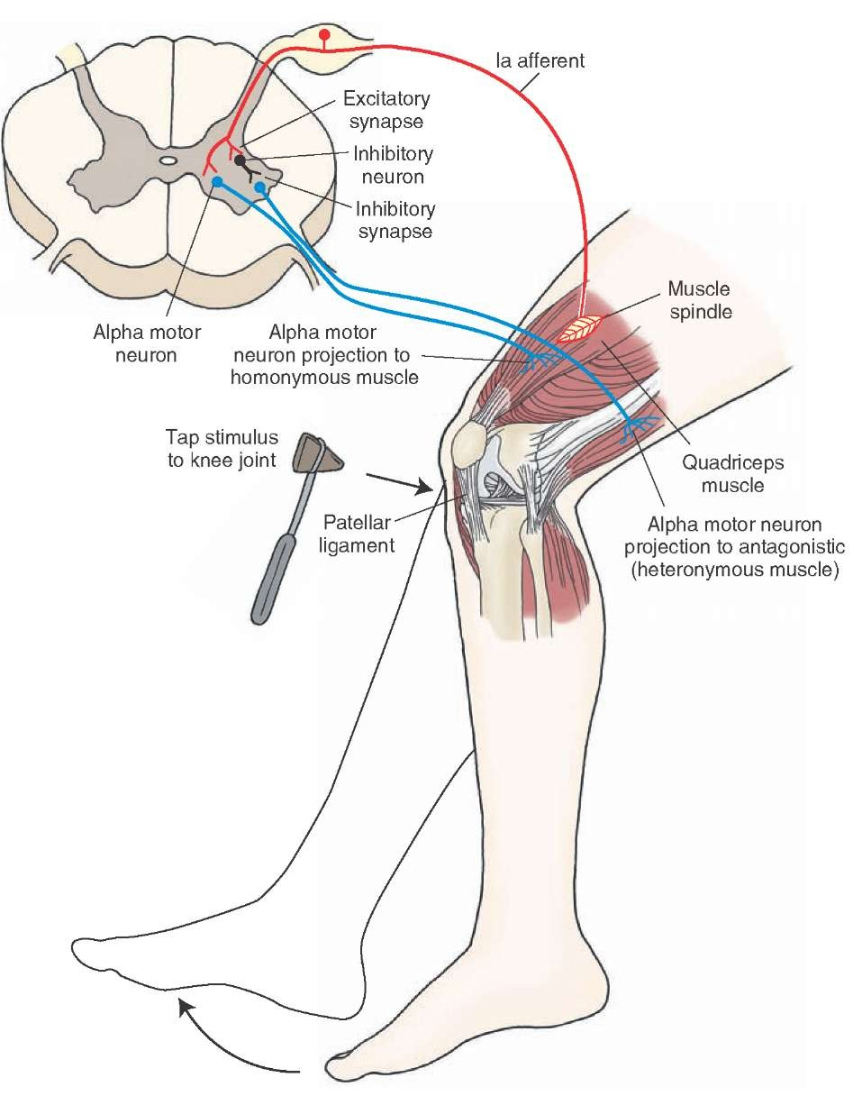

Slide 5
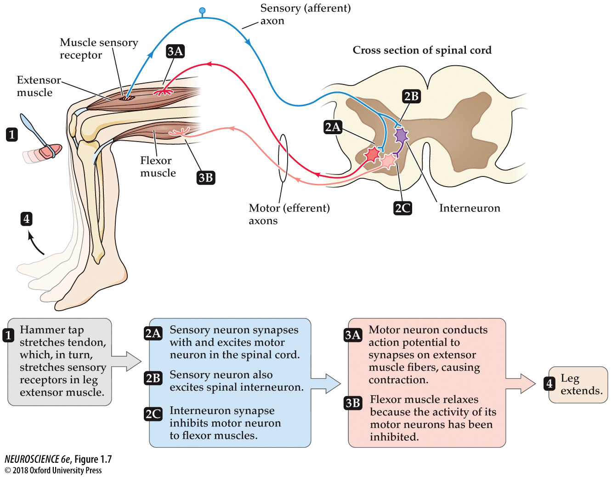

Slide 6
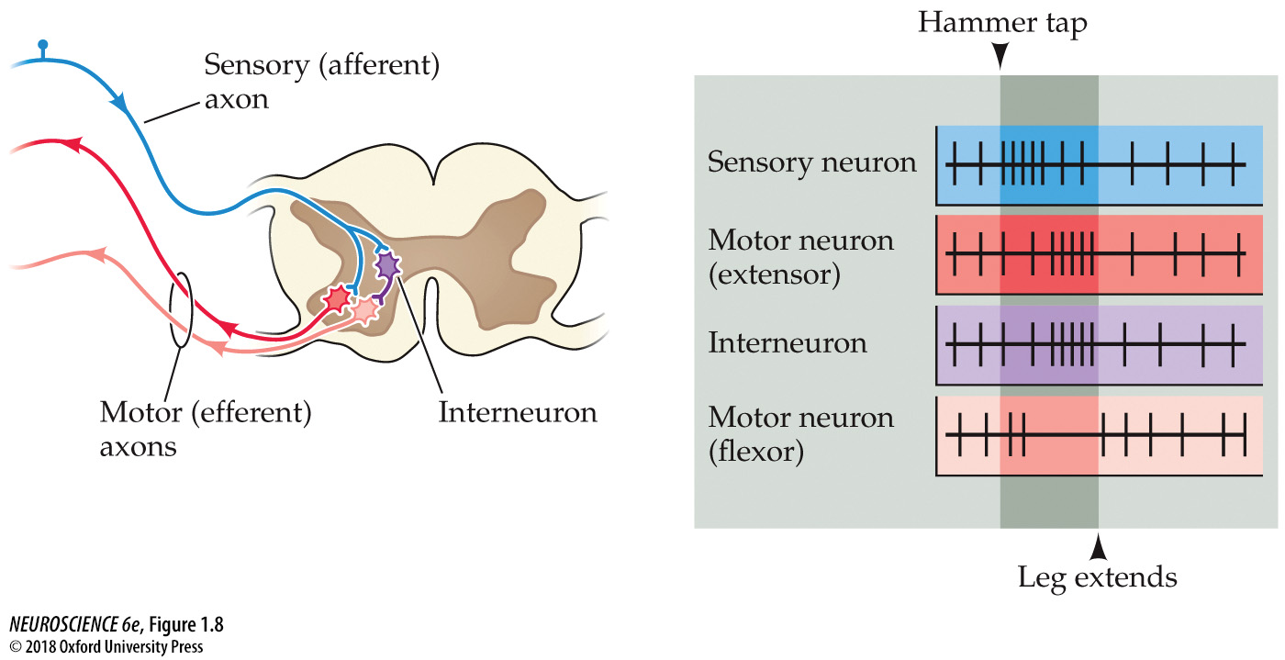

Slide 7
Retina

Slide 8
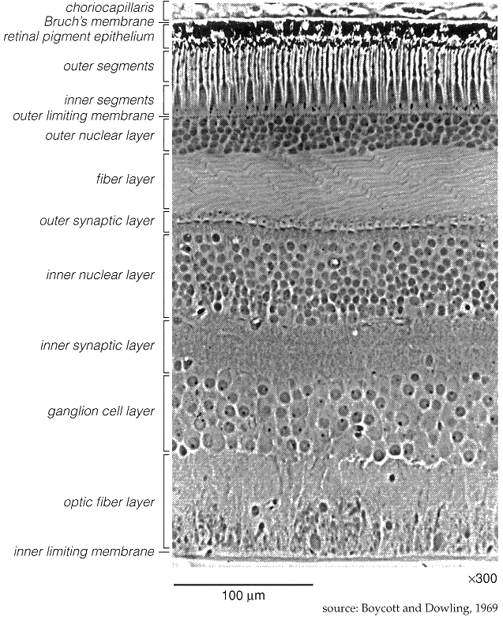
Retinal layering

Slide 9
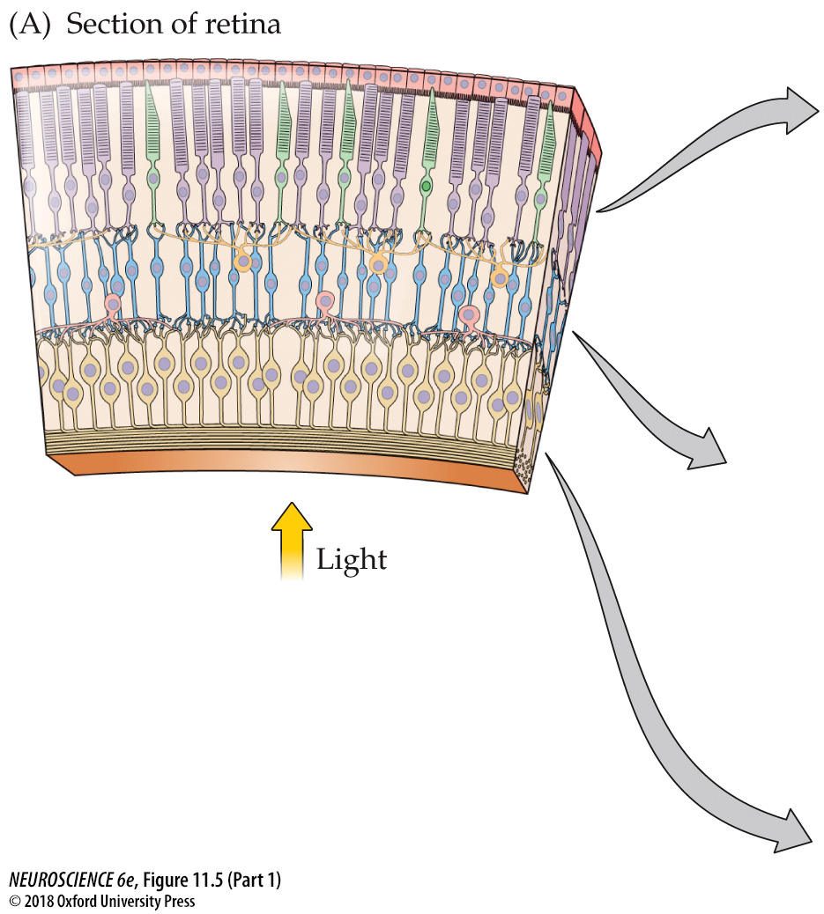
Photoreceptors
Bipolar Cells
Retinal Ganglion Cells

Slide 10
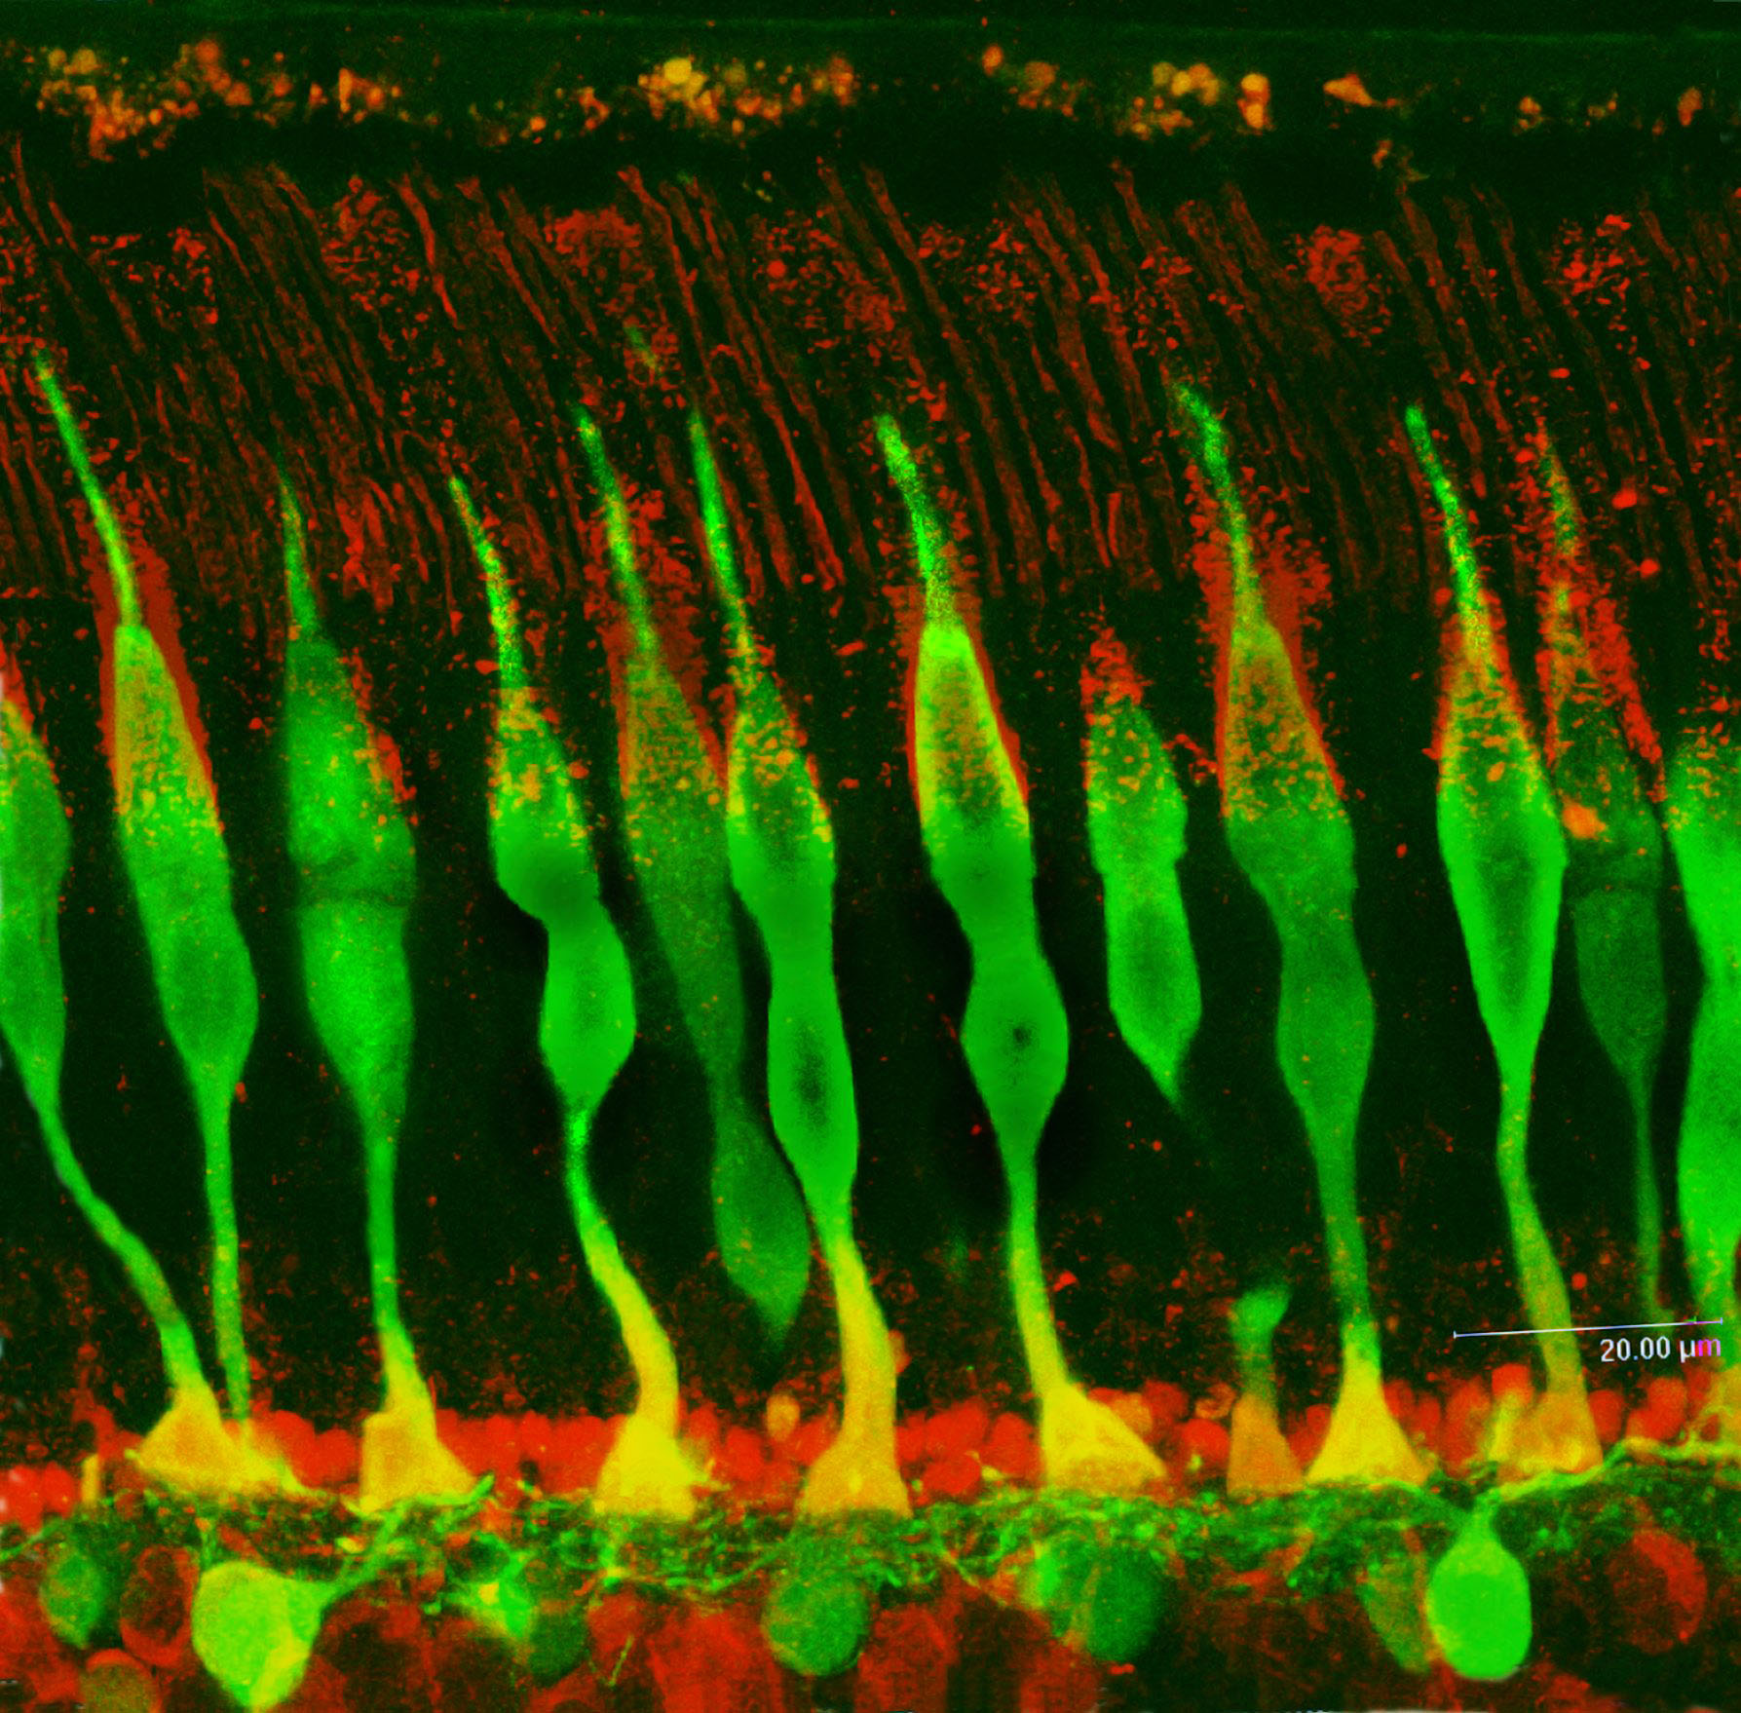

Slide 11
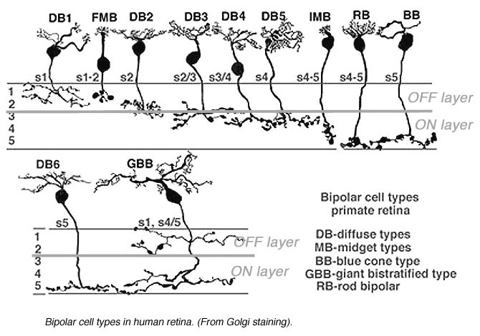
(webvision.med.utah.edu)

Slide 12
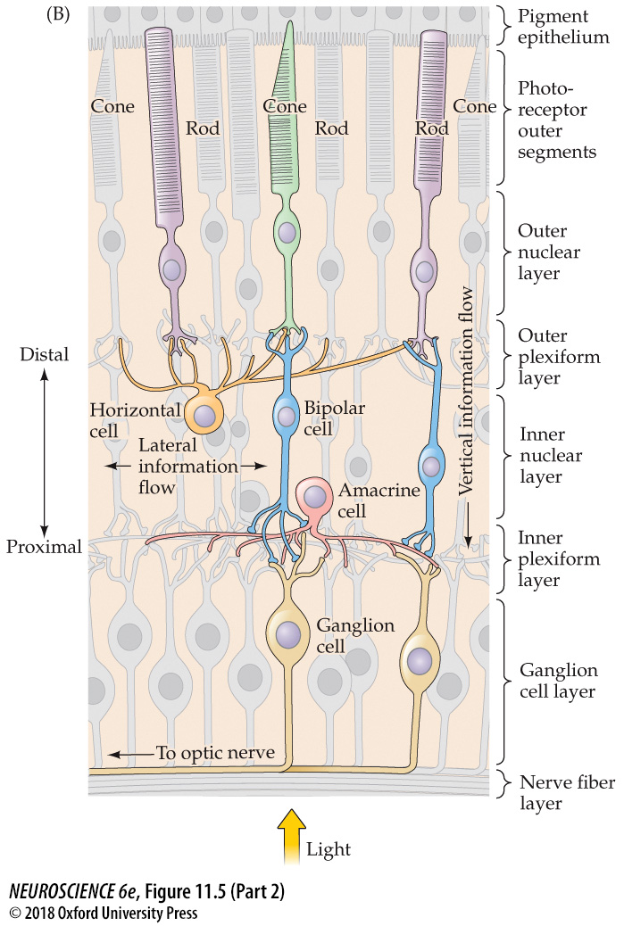

Slide 13
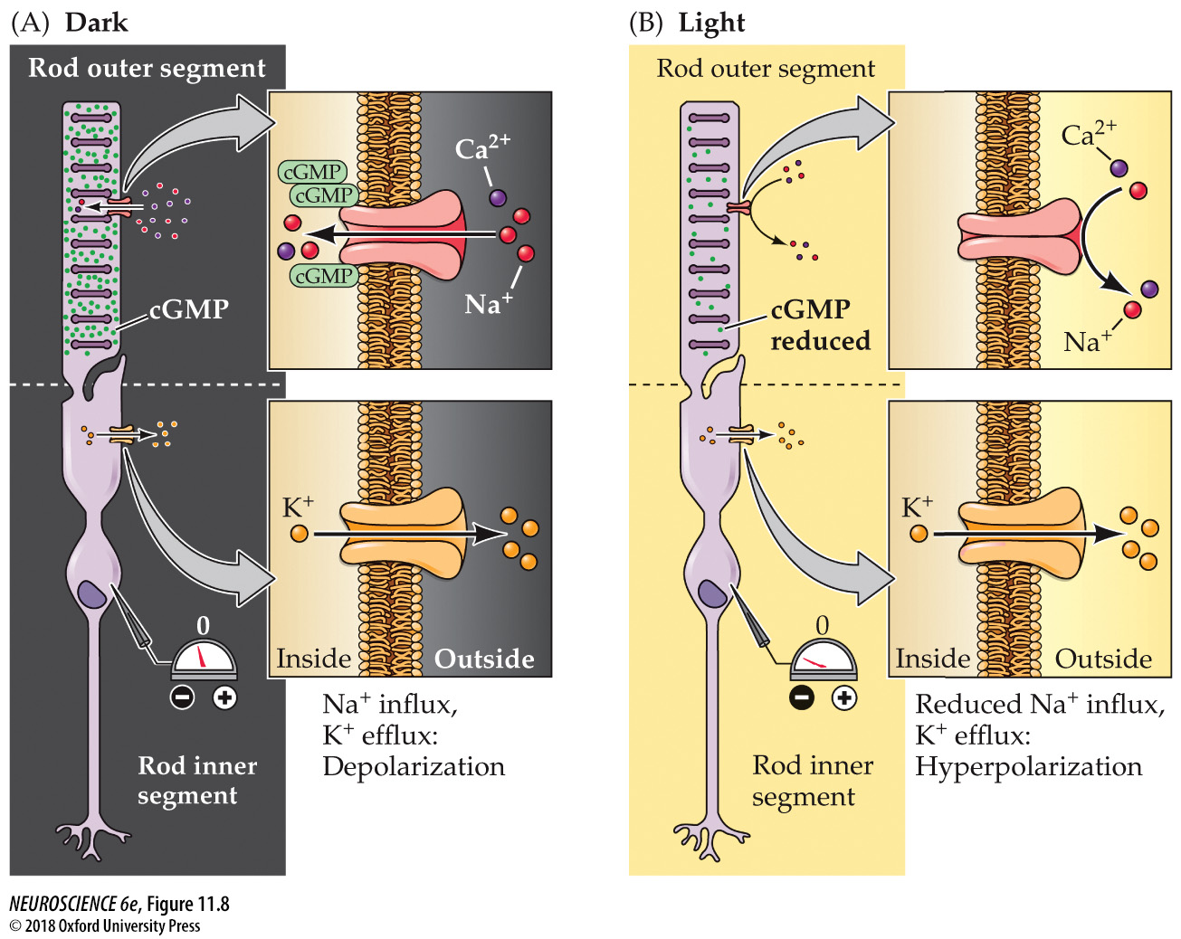
Less NT (glutamate) release in light

Slide 14
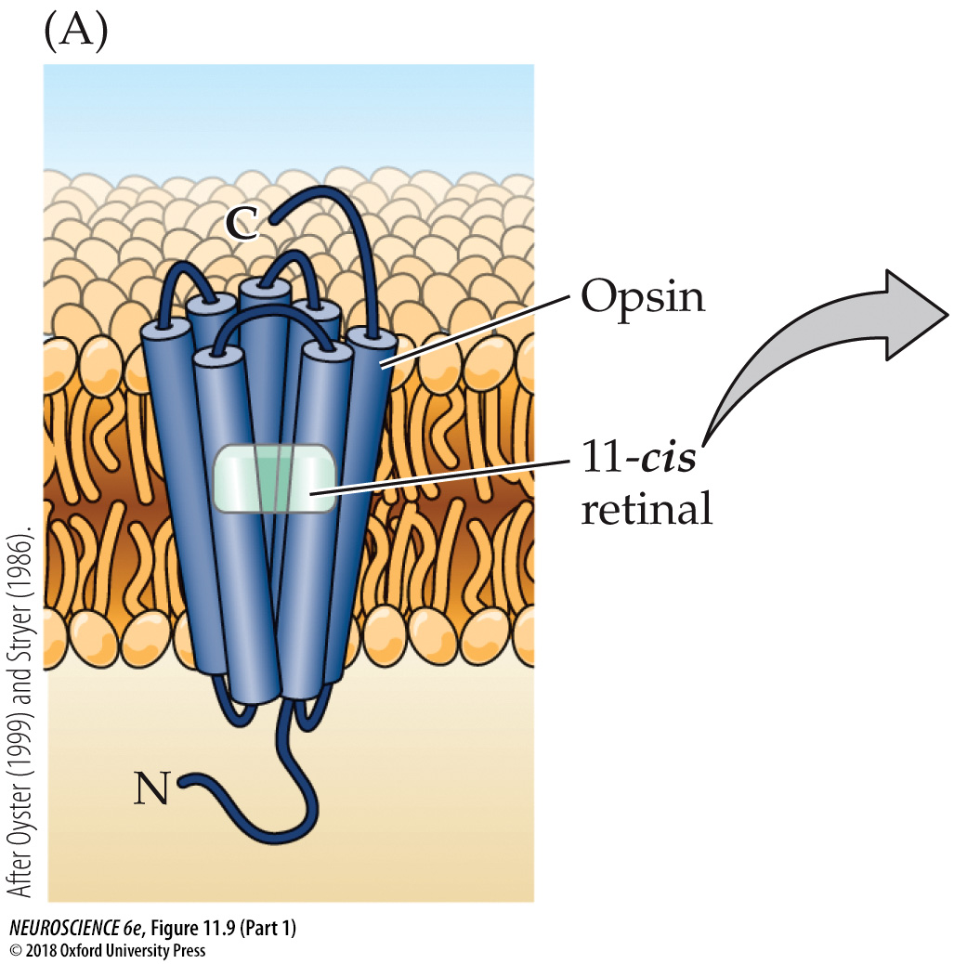
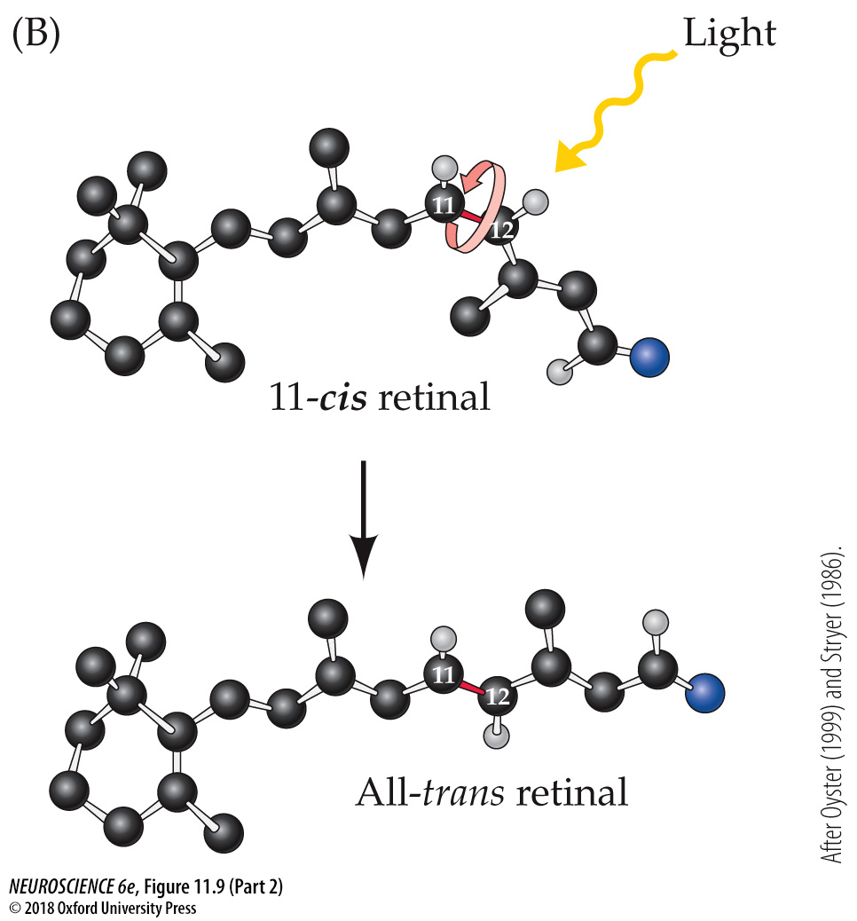

Slide 15
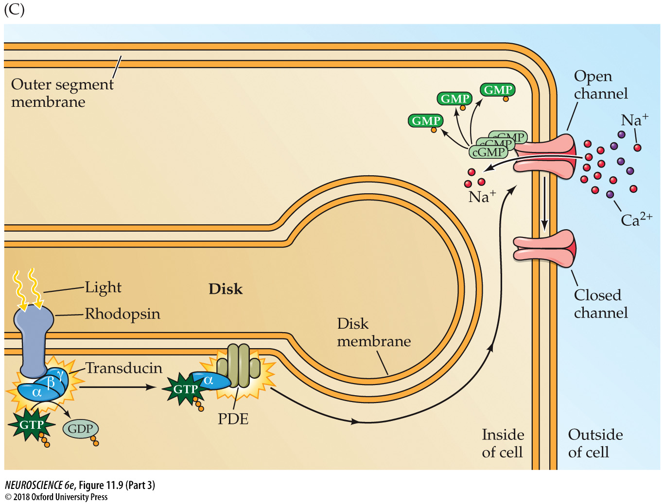
PDE turns cGMP to GMP
cGMP keeps Na⁺ channels open

Slide 16
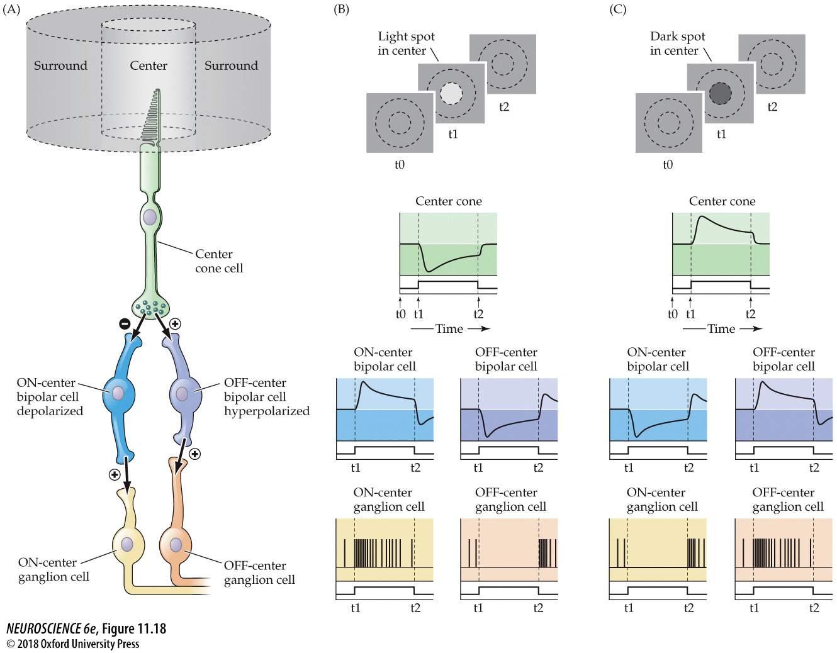
mGluR6
Kainate

Slide 17
OFF and ON retinal pathways

Slide 18
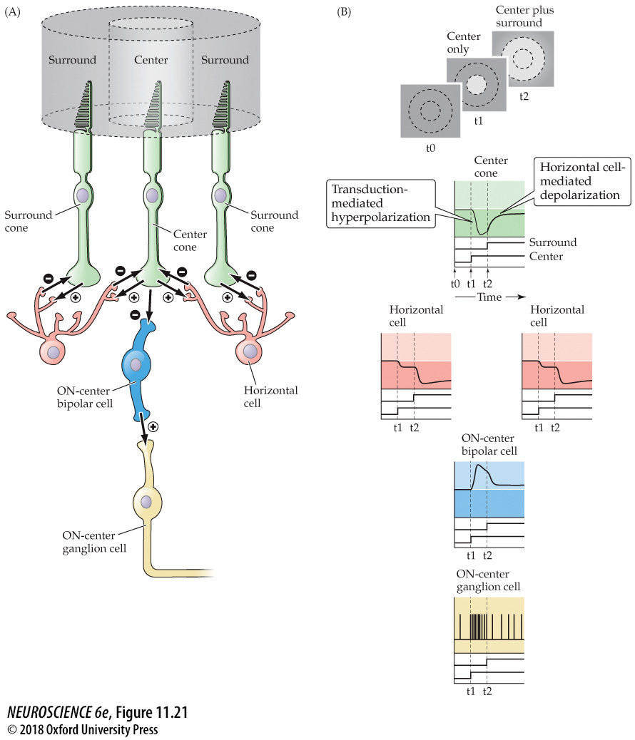

Slide 19
Basal Ganglia

Slide 20
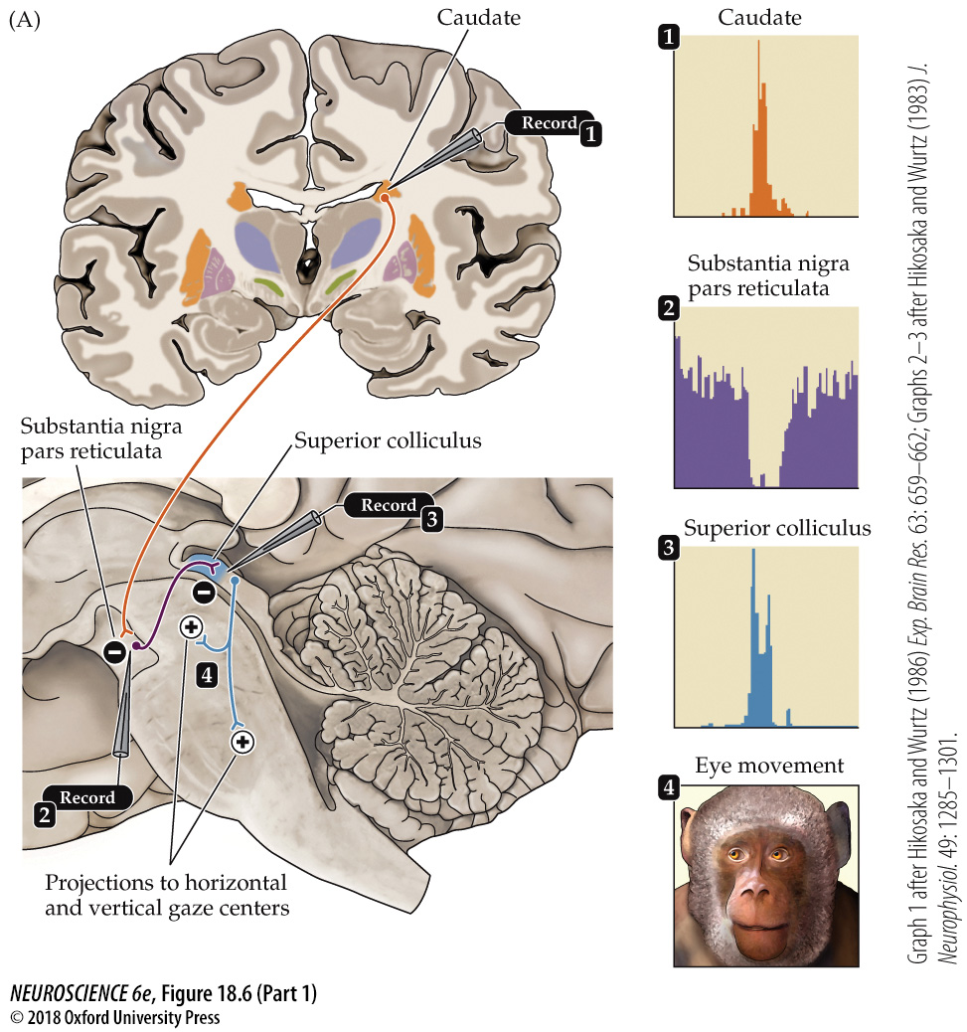

Slide 21
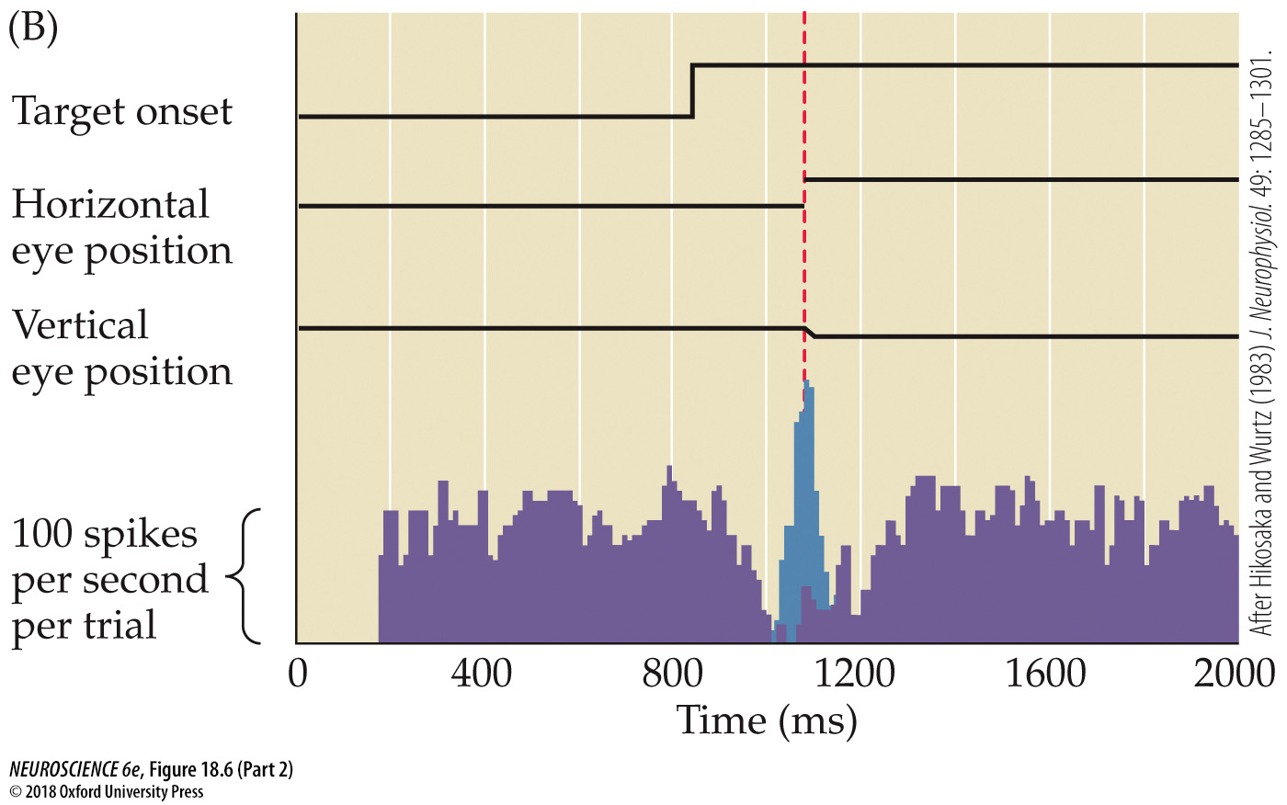
Disinhibition from the neurons of the Substantia Nigra Pars Reticulata leads to firing of neurons in the Superior Colliculus that drives an eye movement

Slide 22
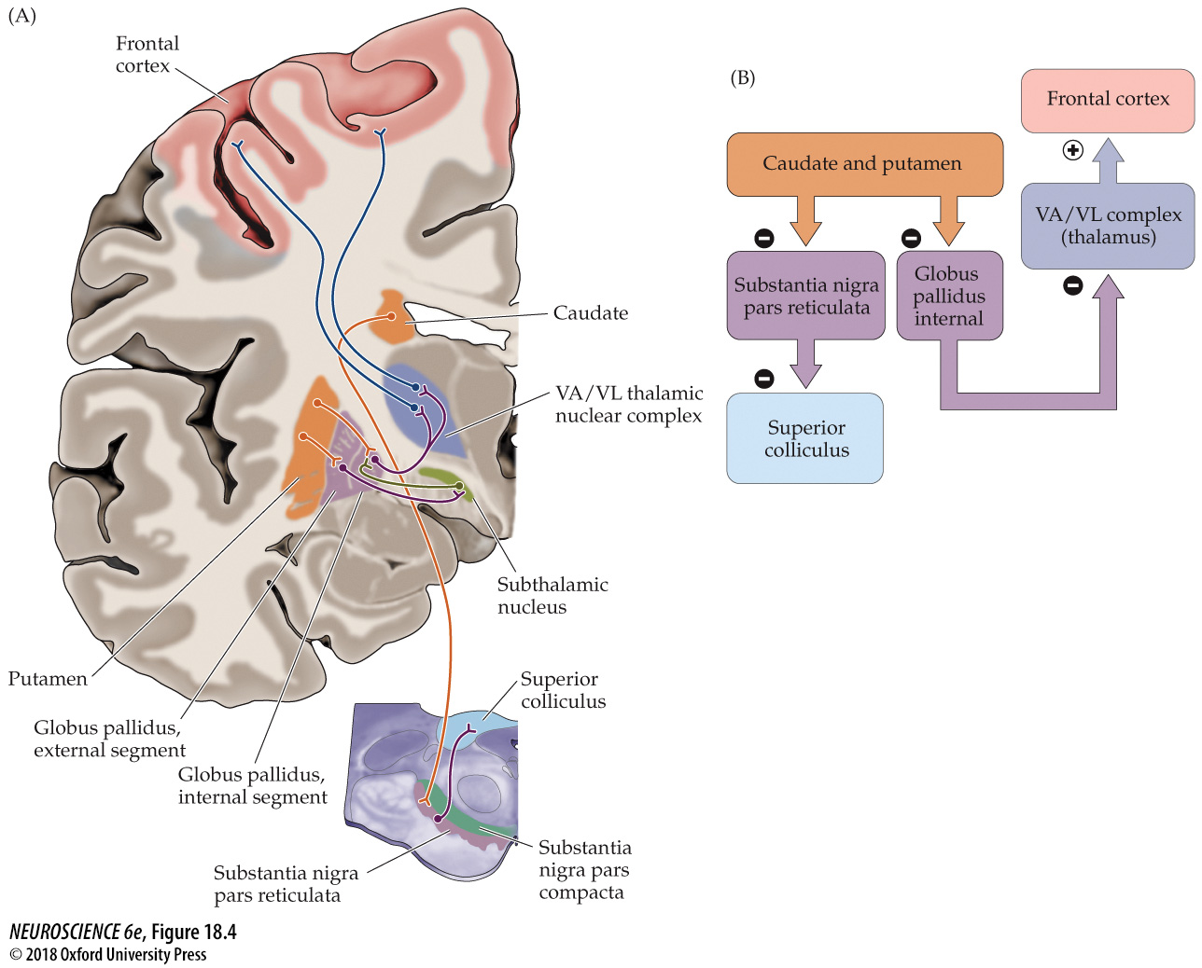

Slide 23
Cerebellum

Slide 24
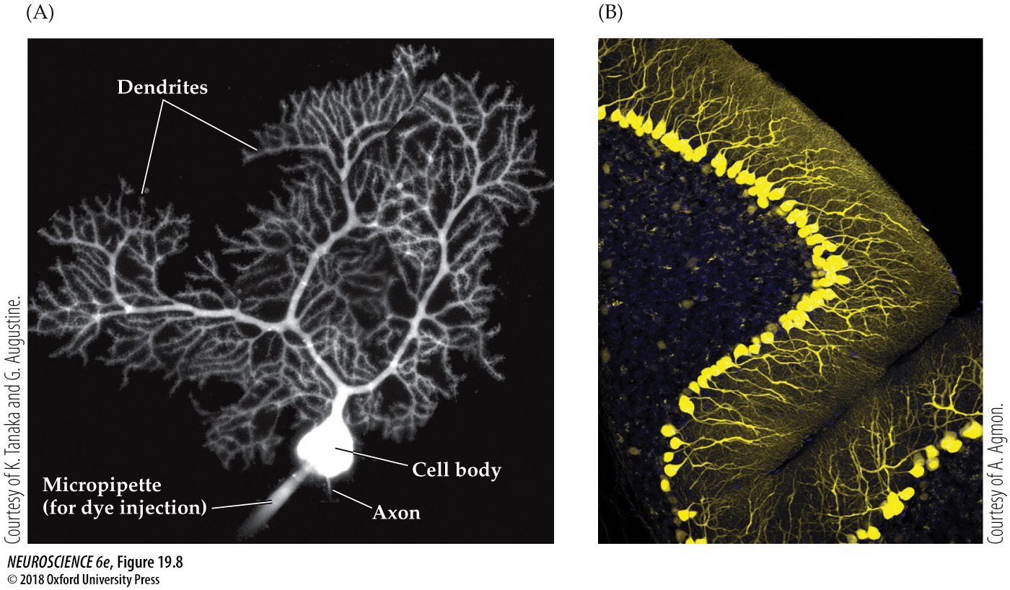
Purkinje Cells

Slide 25
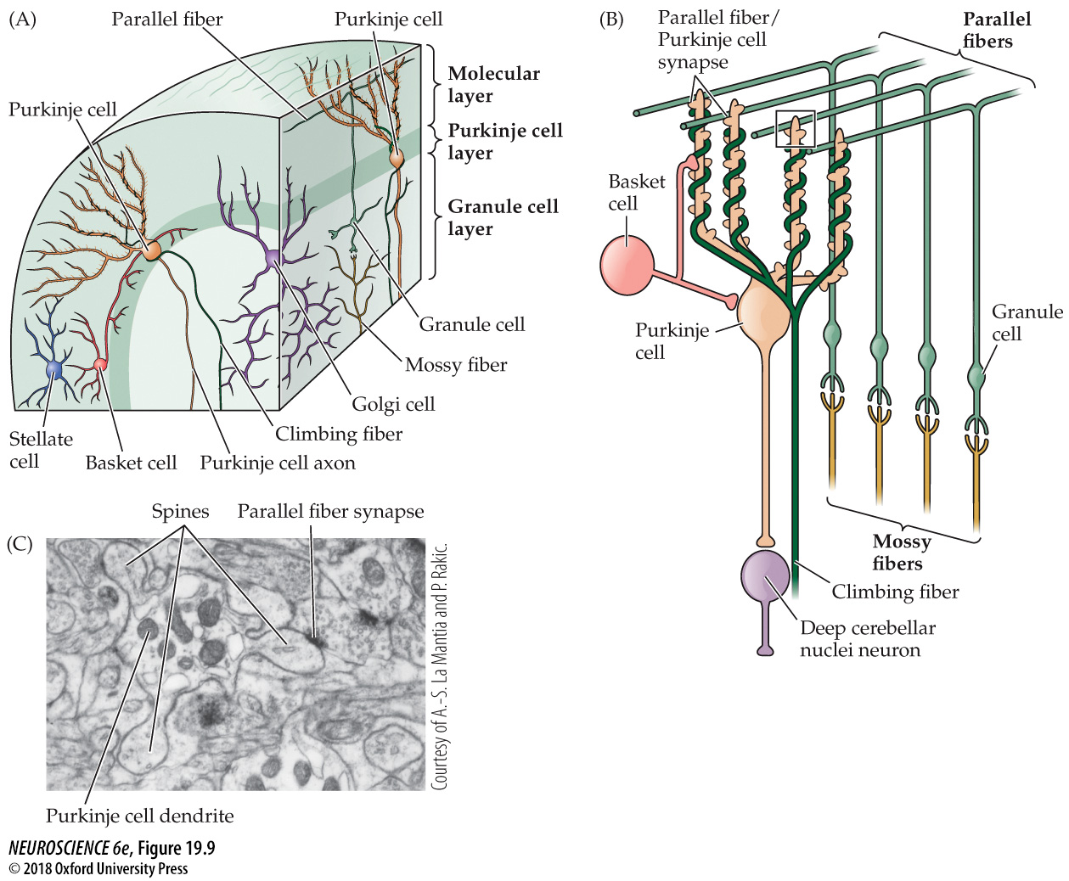

Slide 26
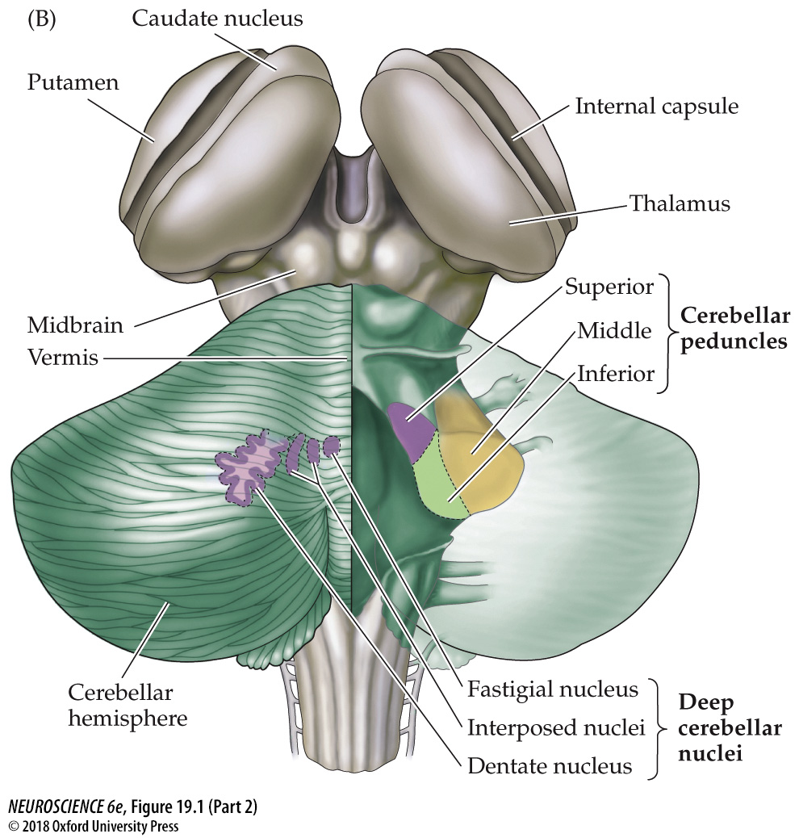

Slide 27
